Slide 1
Regression Analysis
Logistic Regression
Nicoleta Serban, Ph.D.
Professor
Stewart School of Industrial and Systems Engineering
Introduction

Slide 2

About This Lesson

Slide 3
Yes/No Questions
How likely is it that users will like a new layout of our website?
Will my customers leave my wireless service at the end of their subscription?
What financial characteristics can be used to predict whether or not a business will go bankrupt?
➔ Model the probability of ‘Yes’

Slide 4
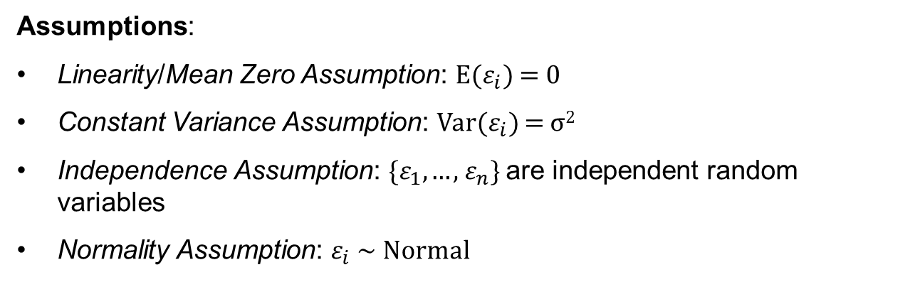
Linear Regression
$$\text{Model}\text{:} {Y_{i}=β}_{0}+β_{1}X_{i,1}+β_{2}X_{i,2}+⋯+β_{p}X_{i,p}+ε_{i} i=1,⋯,n$$
Assumptions:
Linearity/Mean Zero Assumption: E($ε_{i}$) = 0
Constant Variance Assumption: Var($ε_{i}$) = σ²
Independence Assumption: {$ε_{1}$, … , $ε_{n}$} are independent random variables
Normality Assumption: $ε_{i}$ ~ Normal

Slide 5

Linear Regression for Yes/No Question?
Uber recently changed their logo.
You are asked to model whether Uber users will like the new logo based on how much they spent in the last 3 months using Uber.

Slide 6
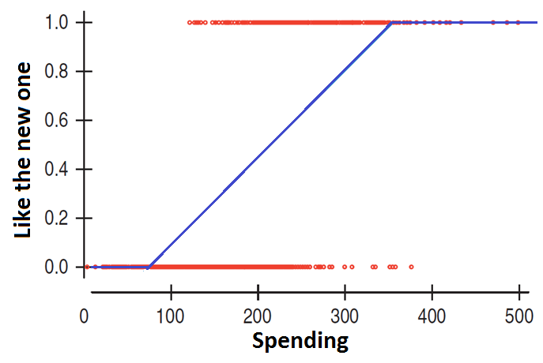
What Is Wrong with Linear Regression?
Customers will not behave like this!

Slide 7
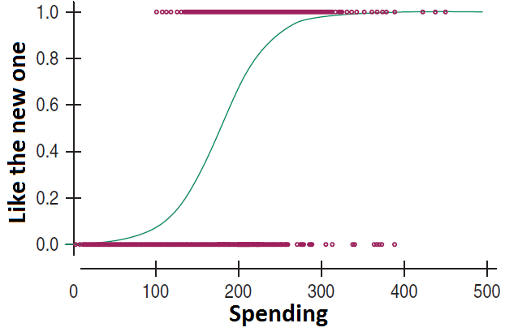
S-shaped Curve

Slide 8
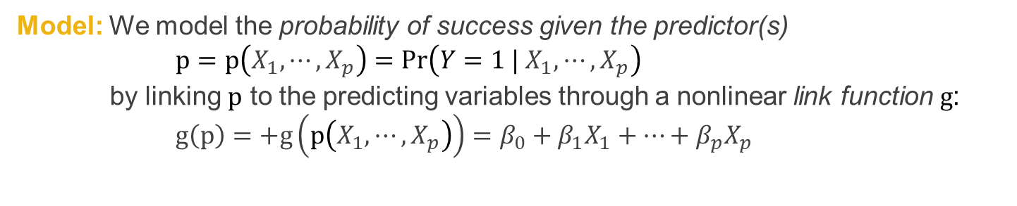
Logistic Regression Model
Data:$\left\{\left(X_{1,1},X_{1,2},⋯,X_{1,p}\right),Y_{1}\right\},\left\{\left(X_{2,1},X_{2,2},⋯,X_{2,p}\right),Y_{2}\right\},⋯,\left\{\left(X_{n,1},X_{n,2},⋯,X_{n,p}\right),Y_{n}\right\}$
where $Y_{1},⋯,Y_{n}$ are binary responses
Model: We model the probability of success given the predictor(s)
$$p=p\left(X_{1},⋯,X_{p}\right)=Pr\left(Y=1 |{ X}_{1},⋯,X_{p}\right)$$
by linking $p$ to the predicting variables through a nonlinear link function $g$:
$$g\left(p\right)=+g\left(p\left(X_{1},⋯,X_{p}\right)\right)=β_{0}+β_{1}X_{1}+⋯+β_{p}X_{p}$$
There is no error term!
What are the model assumptions?

Slide 9
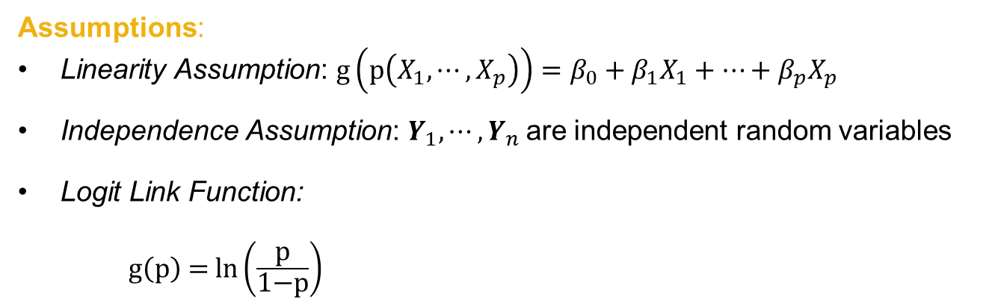
Logistic Regression Model
Data:$\left\{\left(X_{1,1},X_{1,2},⋯,X_{1,p}\right),Y_{1}\right\},\left\{\left(X_{2,1},X_{2,2},⋯,X_{2,p}\right),Y_{2}\right\},⋯,\left\{\left(X_{n,1},X_{n,2},⋯,X_{n,p}\right),Y_{n}\right\}$
where $Y_{1},⋯,Y_{n}$ are binary responses
Assumptions:
Linearity Assumption: $g\left(p\left(X_{1},⋯,X_{p}\right)\right)=β_{0}+β_{1}X_{1}+⋯+β_{p}X_{p}$
Independence Assumption: $Y_{1},⋯,Y_{n}$are independent random variables
Logit Link Function:
$\text{g}\left(\text{p}\right) \text{=} \text{ln}\left(\frac{\text{p}}{\text{1−}\text{p}}\right)$

Slide 10

Summary

